Slide 1








Policy Evaluation
Policies
Policies
Purchasing
Inventory Management
Routing
$$S_{t}$$
$$R_{t}$$
$$x_{t}$$
$$R_{t+1}$$
Environment
$$S_{t+1}$$
$$P_{t}$$
$$S_{t+1},R_{t+1}$$
$$x_{t}$$
Instance Generator
Transition Blocks
Locations
Costs
Inventory
Routing
Offer
Demand

Slide 2



Policy Evaluation
Policies
Agent
$$S_{t}$$
$$R_{t}$$
$$x_{t}$$
$$R_{t+1}$$
Environment
$$S_{t+1}$$

Slide 3



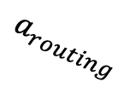

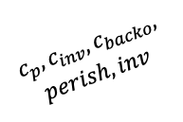
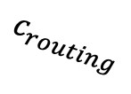

Policy Evaluation
Policies
Routing
Routing
$$a_{routing}$$
Environment
$$a_{t}$$
Purchasing
Transition blocks
$$c_{routing}$$
Policies
$$c_{p},c_{inv},c_{backo},$$
$$perish, inv$$
$$s_{t}$$
Inventory Management
Inventory management
$$a_{purch,inv,dem}$$
$$params$$
$$params$$
Instance generator
Instance generation
Locations
Offer
Demand
Costs

